Slide 1
CODE LAB-II
Programming Skills Portfolio
Asif Yousaf

Slide 2
Table Of Contents
Chapter 1 - Python Refresher
Chapter 2 - Graphical User Interface
Chapter 3 - Graphical User Interface(Cont.)
Chapter 4 - File Handling and Regular Expressions
Chapter 5 - Object Oriented Programming
Chapter 6 - Python Standard Library Modules

Slide 3
Chapter 1 - Python Refresher
Exercises, Bonus And Further

Slide 4
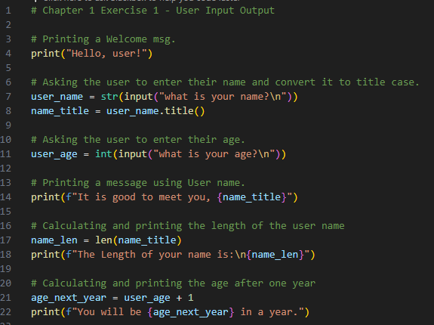
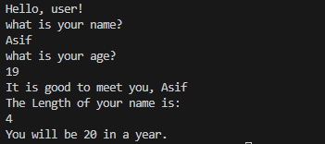
Chapter 1 Ex 1 – User Input Output
This code demonstrates a simple program that interacts with the user, capturing their name and age, and providing personalized messages based on the input. Below, you'll find the Python code, its corresponding output, and additional comments explaining each step.
Code
Output

Slide 5
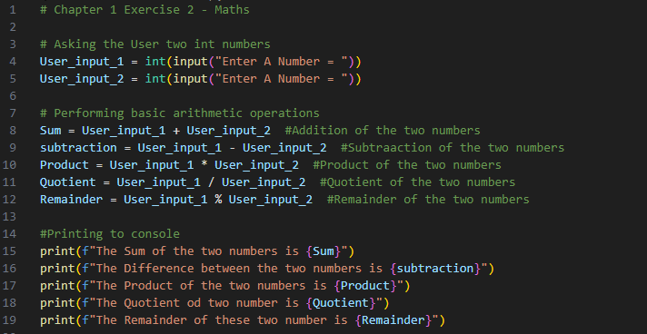
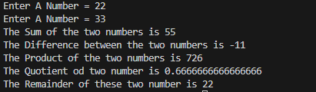
Chapter 1 Ex 2 - Math's
This code demonstrates a straightforward mathematical program that interacts with the user. It prompts the user to input two integer numbers, performs basic arithmetic operations (addition, subtraction, multiplication, division, and modulo), and outputs the results. Below, you'll find the Python code, its corresponding output, and additional comments explaining each step.
Code
Output

Slide 6
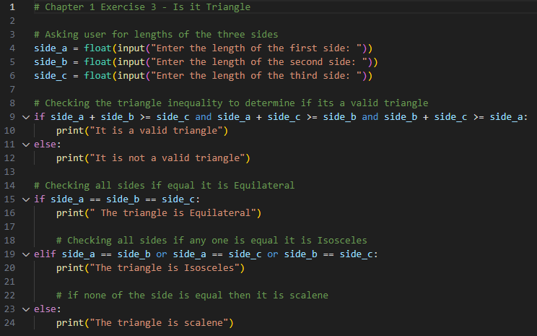
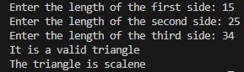
Chapter 1 Ex 3 - Is it Triangle
This code prompts the user to enter the lengths of three sides of a triangle. It then checks the triangle inequality to determine whether the provided side lengths form a valid triangle. If valid, the code proceeds to classify the triangle as Equilateral, Isosceles, or Scalene based on the side lengths. Below, you'll find the Python code, its corresponding output, and additional comments explaining each step.
Code
Output

Slide 7
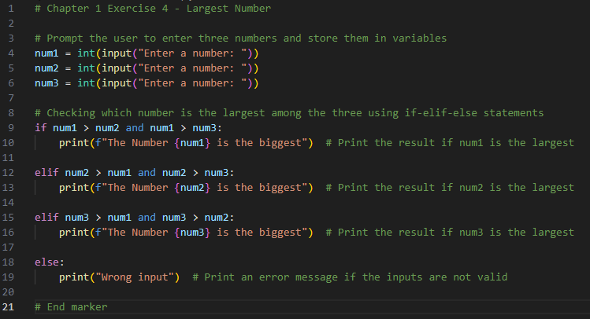
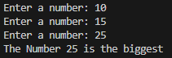
Chapter 1 Ex 4 - Largest Number
This code prompts the user to enter three numbers, compares them, and identifies the largest among them. The Python code, along with its corresponding output and additional comments explaining each step, is presented below:
Code
Output

Slide 8
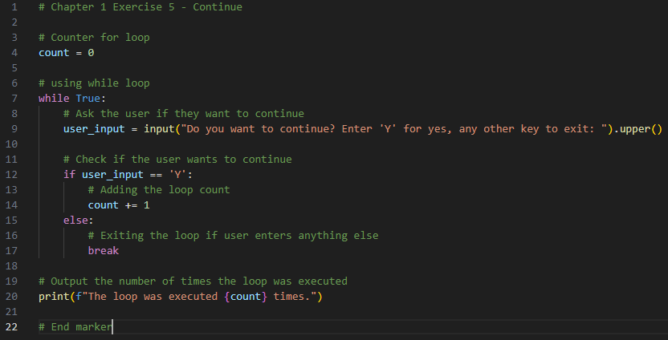
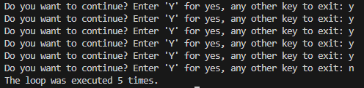
Chapter 1 Ex 5 - Continue
This code presents a simple program utilizing a while loop that interacts with the user, prompting them to continue or exit by entering 'Y' or any other key, respectively. The loop keeps track of how many times it executes, and the final count is printed as output. Below, you'll find the Python code, its corresponding output, and additional comments explaining each step.
Code
Output

Slide 9
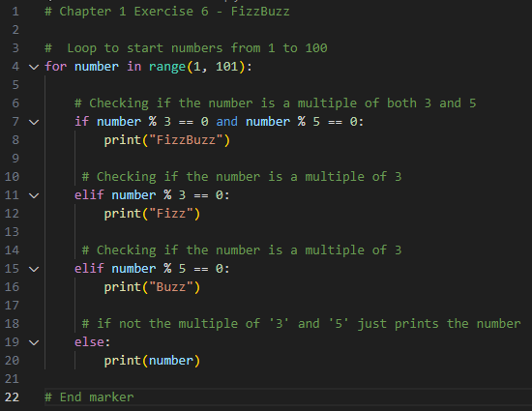
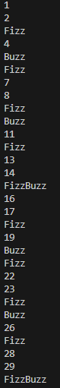
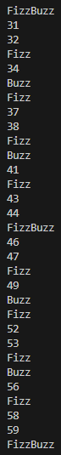
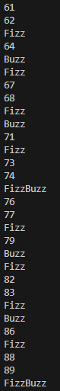
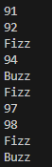
Chapter 1 Ex 6 - Fizz Buzz
This code demonstrates the classic Fizz Buzz problem. It iterates through numbers from 1 to 100 and prints "Fizz" for multiples of 3, "Buzz" for multiples of 5, "Fizz Buzz" for numbers that are multiples of both 3 and 5, and the number itself otherwise. Below, you'll find the Python code, its corresponding output, and additional comments explaining each step.
Code
Output

Slide 10
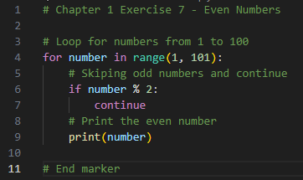
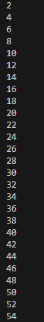
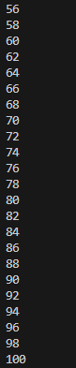
Chapter 1 Ex 7 - Even Numbers
This code generates and prints even numbers between 1 and 100. The program uses a loop to iterate through numbers from 1 to 100. Odd numbers are skipped using the 'continue' statement, and only even numbers are printed. Finally, an end marker indicates the completion of the program.
Code
Output

Slide 11
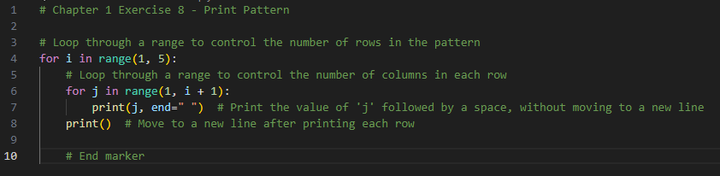
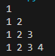
Chapter 1 Ex 8 - Print Pattern
This code presents a simple Python program that generates a numeric pattern. The program utilizes nested loops to control the number of rows and columns, creating a pattern where each row displays sequential numbers. The Python code, its corresponding output, and additional comments detailing each step are provided below.
Code
Output

Slide 12
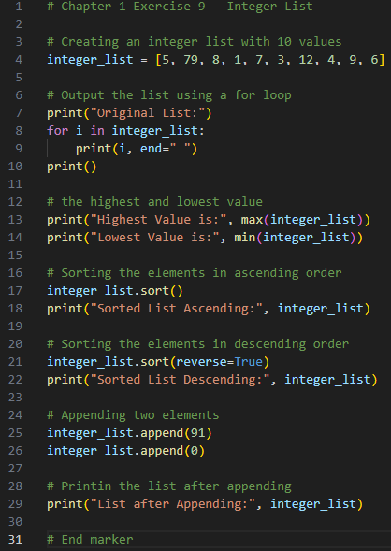
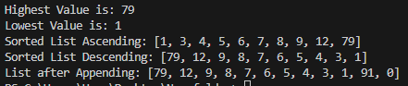
Chapter 1 Ex 9 - Integer List
This code demonstrates a program that works with an integer list. It creates a list, outputs its original form, finds the highest and lowest values, sorts the list in ascending and descending order, appends two elements, and prints the final list.
Code
Output

Slide 13
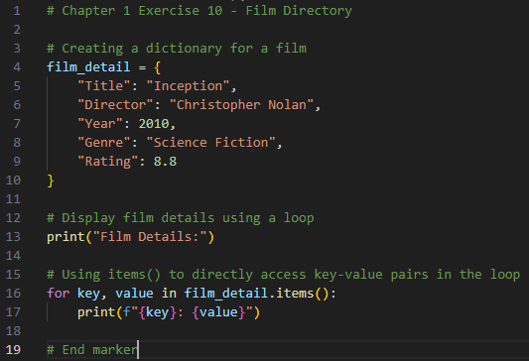
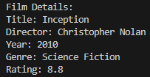
Chapter 1 Ex 10 - Film Dictionary
This code creates a simple film directory using a Python dictionary. The dictionary contains details such as the film title, director, release year, genre, and rating. The program then displays these film details using a loop, showcasing how to iterate through key-value pairs. Below, you'll find the Python code, its corresponding output, and additional comments explaining each step.
Code
Output

Slide 14
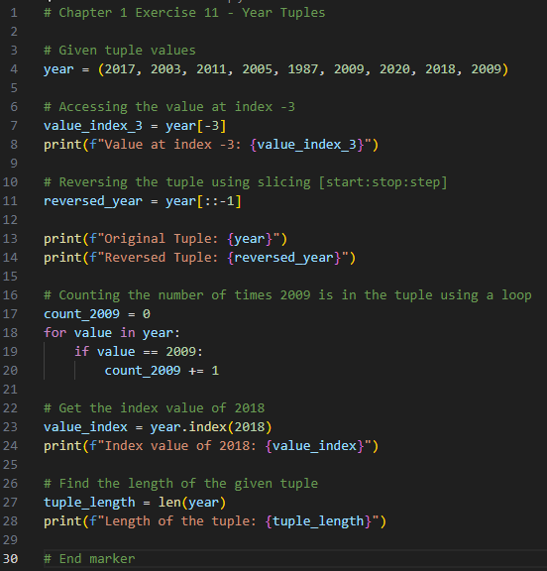
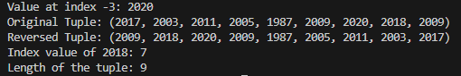
Chapter 1 Ex 11 - Year Tuples
This code explores the manipulation of a tuple containing various years. It demonstrates the retrieval of a specific value, the reversal of the entire tuple, counting occurrences of a particular year, obtaining the index of a specified value, and determining the length of the tuple. Below, you'll find the Python code, its corresponding output, and additional comments explaining each step.
Code
Output

Slide 15
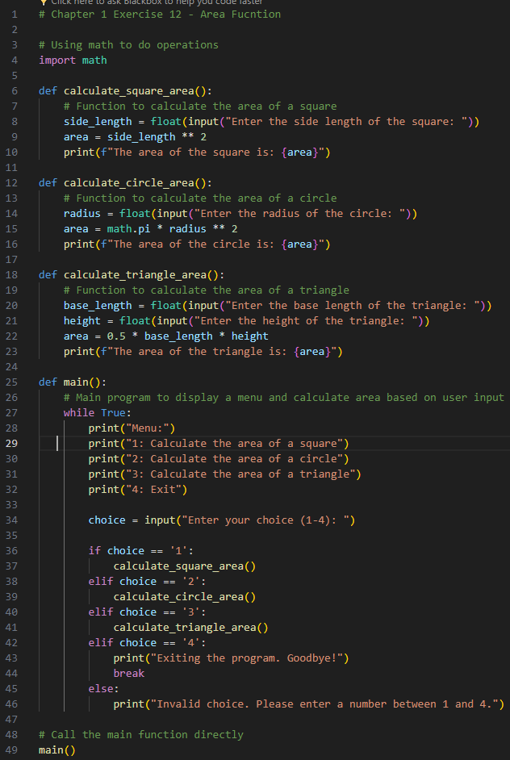
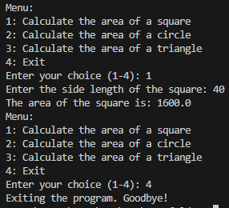
Chapter 1 Ex 12 - Area Function
This code calculates the area of geometric shapes (square, circle, triangle). It uses functions for each shape, a menu for user interaction, and the math module for circle calculations. Below is the Python code, its output, and comments explaining each step.
Code
Output

Slide 16
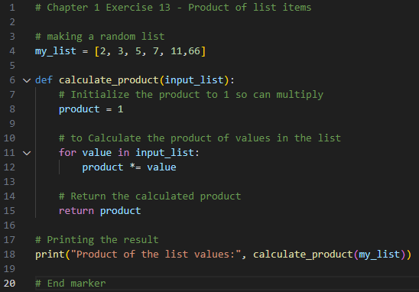
Chapter 1 Ex 13 - Product of list items
This code showcases a simple program that calculates the product of values in a given list. The provided Python code, its corresponding output, and explanatory comments are presented below.
Code
Output

Slide 17
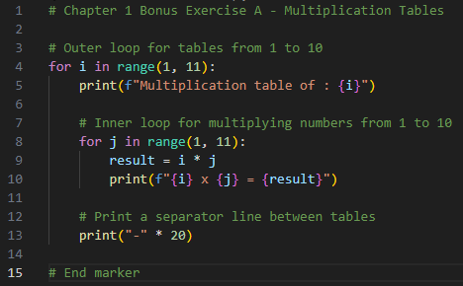
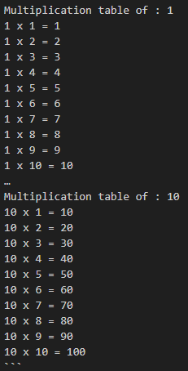
Chapter 1 Bonus Ex A - Multiplication Tables
This code generates multiplication tables for numbers 1 through 10. It utilizes nested loops to iterate through each multiplication table and displays the results. Below, you'll find the Python code, its corresponding output, and additional comments explaining each step.
Code
Output

Slide 18
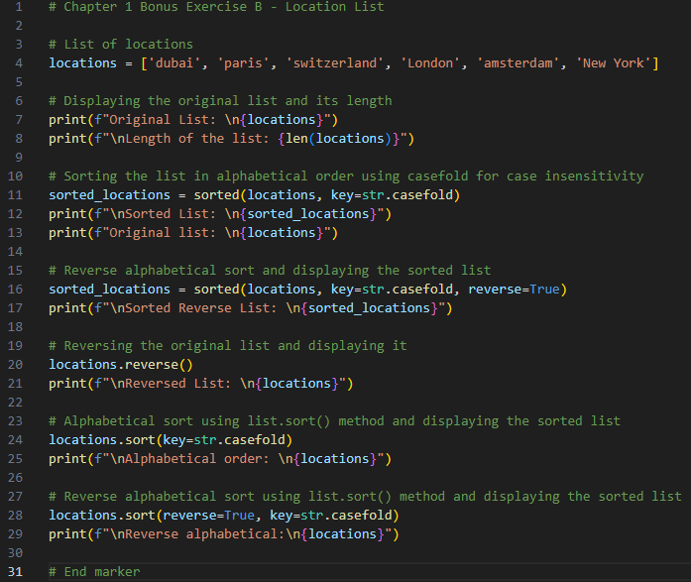
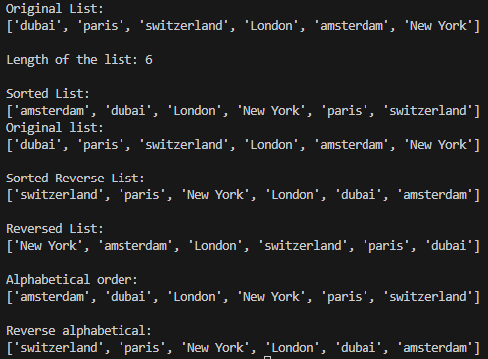
Chapter 1 Bonus Ex B - Locations List
This code demonstrates the manipulation of a list of locations. The original list is displayed, sorted in different ways, reversed, and then sorted in place. Below, you'll find the Python code, its corresponding output, and additional comments explaining each step.
Code
Output

Slide 19
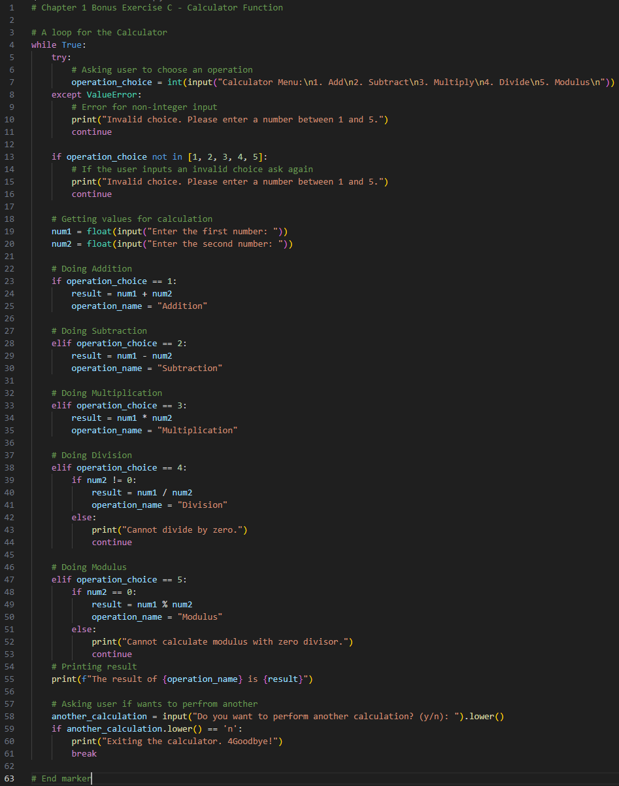
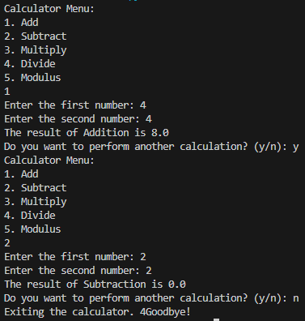
Chapter 1 Bonus Ex C - Calculator Function
This code implements a simple calculator using a loop to allow the user to perform multiple calculations. while True:
Code
Output

Slide 20
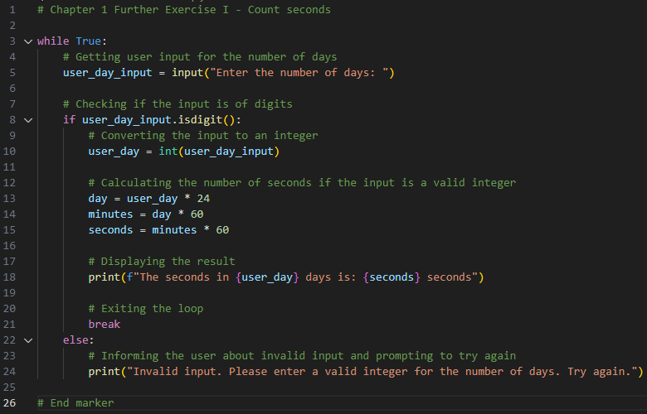
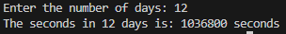
Chapter 1 Further Ex I - Count seconds
This code presents a program that prompts the user to enter the number of days and calculates the corresponding number of seconds. The program ensures valid input by checking if the user's input consists of digits. Below, you'll find the Python code, its corresponding output, and additional comments detailing each step.
Code
Output

Slide 21
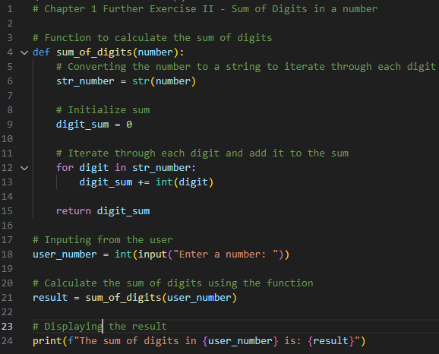
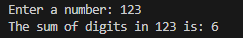
Chapter 1 Further Ex II - Sum of Digits in number
This code presents a program that calculates the sum of digits in a given number. It defines a function, sum of digits, which takes an integer as input, converts it to a string to iterate through each digit, and computes the sum. The user is prompted to input a number, and the program displays the result – the sum of digits in the entered number.
Code
Output

Slide 22
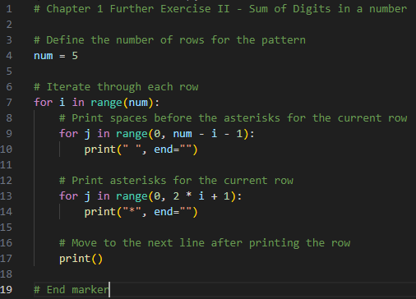
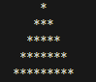
Chapter 1 Further Ex III - Arrows
This code showcases a simple program that generates a pattern using asterisks. The pattern consists of rows where the number of asterisks in each row increases incrementally, creating a visually appealing pyramid-like structure. The number of rows in the pattern is set to 5, but this can be easily adjusted.
Code
Output

Slide 23
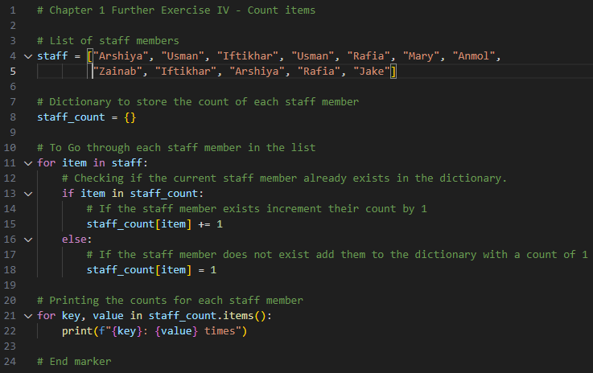
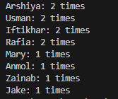
Chapter 1 Further Ex IV - Count items
This code demonstrates a program that counts the occurrences of each staff member in a given list. It uses a dictionary to store the count of each staff member and iterates through the list, updating the counts accordingly. The final output displays the count for each staff member. Below, you'll find the Python code, its corresponding output, and additional comments explaining each step.
Code
Output

Slide 24
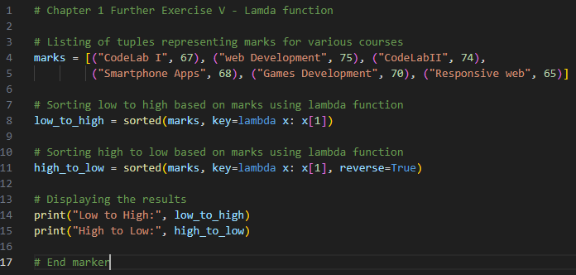
Chapter 1 Further Ex V - Lamda function
This code utilizes lambda functions to sort a list of tuples representing marks for various courses. The tuples consist of the course name and the corresponding mark.
Code
Output

Slide 25
Chapter 2 - Graphical User Interface
Exercises, Bonus And Further

Slide 26
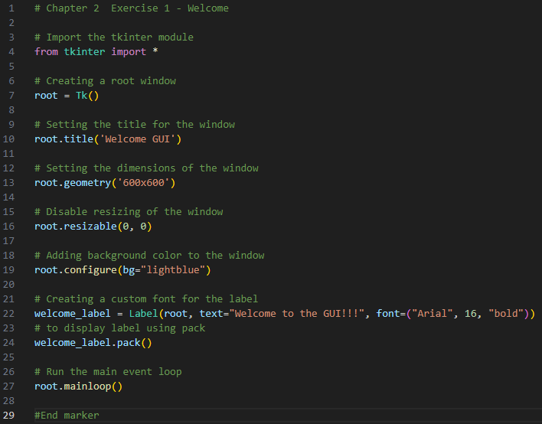
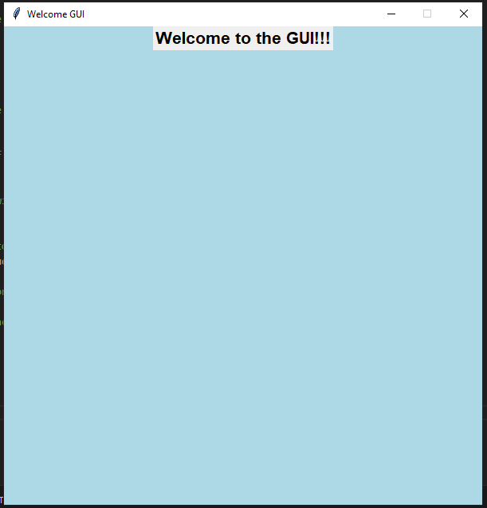
Chapter 2 Ex 1 - Welcome
This code demonstrates a simple graphical user interface (GUI) program using the tkinter module. The program creates a window with a welcoming message. Below, you'll find the Python code, its corresponding output, and additional comments explaining each step.
Code
Output

Slide 27
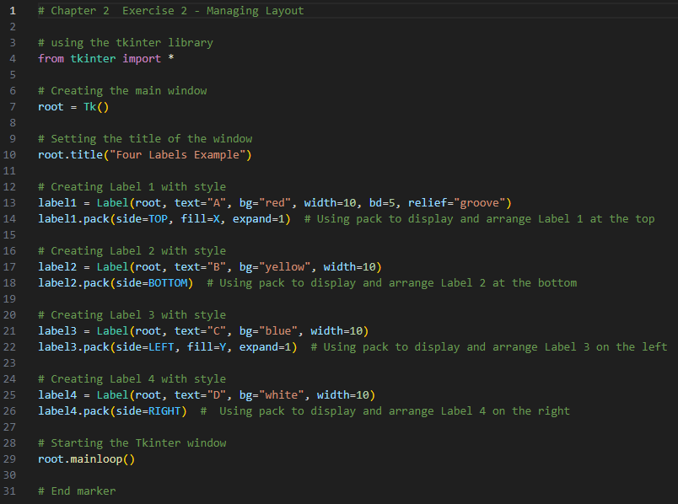
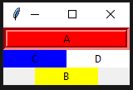
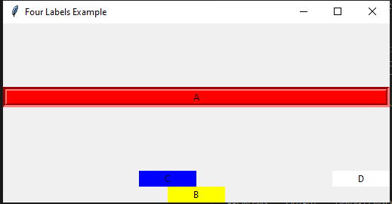
Chapter 2 Ex 2 - Managing Layout
This code showcases the use of the Tkinter library to create a simple GUI with four labels. Each label is styled differently and arranged at different positions within the main window.
Code
Output

Slide 28
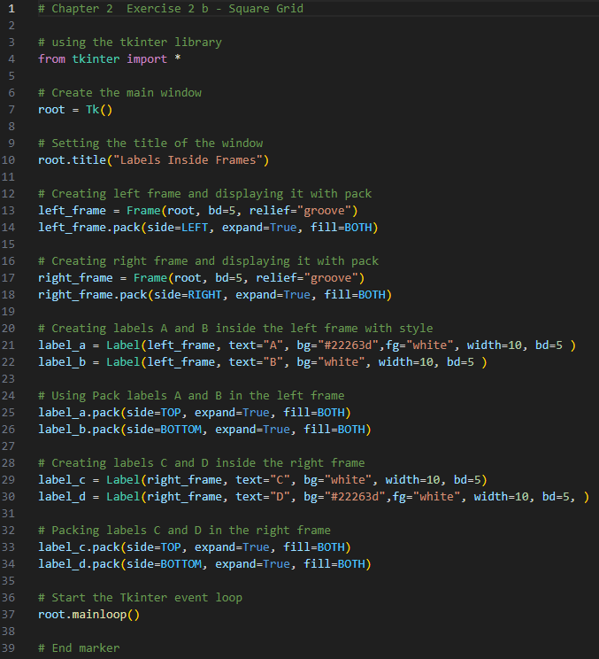

Chapter 2 Ex 2 b - Square Grid
This code showcases a simple graphical user interface (GUI) program using the tkinter library. The program creates a window with two frames, each containing labeled elements.
Code
Output

Slide 29


Chapter 2 Ex 3 - Login page
GUI-based login page using tkinter with welcome message, username/password entry, submit button, and result label.
Code
Output

Slide 30


Chapter 2 Ex 4 – Registration page
This Python code utilizes Tkinter to create a student registration GUI. The form captures essential details: name, mobile number, email, address, gender, enrolled course, languages, and English communication skills. The breakdown includes code and output
Code

Slide 31

Chapter 2 Ex 4 – Registration page
Output

Slide 32



Chapter 2 Ex 5 - Calculator
This Python code uses tkinter to create a basic calculator with GUI. Users can perform addition, subtraction, multiplication, division, and modulo operations. The result is displayed on the interface, with comments explaining each function.
Output
Code

Slide 33



Chapter 2 Ex A Bonus - Temperature Converter
This code uses tkinter for a simple Celsius to Fahrenheit and Fahrenheit to Celsius converter. See the code, output, and comments below
Code
Output

Slide 34



Chapter 2 Ex B Bonus - Age Calculator
This code uses tkinter for a simple Celsius to Fahrenheit and Fahrenheit to Celsius converter. See the code, output, and comments below
Code
Output

Slide 35

Chapter 2 Further Ex I - Count characters
This code demonstrates a program using the tkinter library to count the number of vowels, consonants, special characters, and total letters in a given sentence.
Code
Output

Slide 36


Chapter 2 Further Ex II - Capitalize letters
Tkinter app for capitalizing user text. GUI with entry, capitalization button, and result label. capitalize_text converts input to uppercase, updating the result label. Tkinter event loop starts.
Code
Output

Slide 37
Chapter 3 - Graphical User Interface
Exercises, Bonus And Further

Slide 38



Chapter 3 Ex 1 - Greeting App
Captures user name and color choice for personalized greeting. Output: Tkinter window with entry fields, dropdown, and display label. Comments provide step-by-step explanation.
Code
Output

Slide 39



Chapter 3 Ex 2 - Coffee Vending Machine
This code allows users to select coffee type, sugar, and milk, and calculates the cost of the order. It provides feedback on the total cost and change after the user enters the payment amount.
Code

Slide 40


Chapter 3 Ex 2 - Coffee Vending Machine
This code allows users to select coffee type, sugar, and milk, and calculates the cost of the order. It provides feedback on the total cost and change after the user enters the payment amount.
Output

Slide 41




Chapter 3 Ex 3 – Area Function
Area Calculator using tkinter for circle, square, and rectangle. Entry widgets, Calculate buttons, and result labels provide a user-friendly interface.Functions validate inputs, and ttk module creates a tabbed interface for each shape.
Code

Slide 42


Chapter 3 Ex 4 - Draw Shape
This code demonstrates a program using the tkinter library to draw shapes based on user input. The main window includes a canvas for drawing, a dropdown menu to select a shape, and a button to initiate the drawing.
Code
Output

Slide 43


Chapter 3 Bonus - Burger Shack Vendor
Simulates a burger shack vendor program. Users choose burgers, customize, and view transactions. Provides a transaction history with total cost and remaining balance. Python code, console output, and comments are detailed below.
Code

Slide 44


Chapter 3 Bonus - Burger Shack Vendor
Simulates a burger shack vendor program. Users choose burgers, customize, and view transactions. Provides a transaction history with total cost and remaining balance. Python code, console output, and comments are detailed below.
Code

Slide 45


Chapter 3 Bonus - Burger Shack Vendor
Simulates a burger shack vendor program. Users choose burgers, customize, and view transactions. Provides a transaction history with total cost and remaining balance. Python code, console output, and comments are detailed below.
Output

Slide 46




Chapter 3 Further Ex I - Vending Machine
Simple vending machine program using Tkinter and messagebox. Users can select items, enter quantity, and amount paid for a simulated purchase. The program checks stock, calculates the cost, and provides user feedback.
Code
Output

Slide 47




Chapter 3 Further Ex II - Guess Word
This code uses Tkinter to create a word guessing game. Users unscramble shuffled words, and the program checks their guesses, updates the score, and provides feedback. Code, output, and comments are included for clarity.
Code
Output

Slide 48
Chapter 4 - File Handling & Regular Expressions
Exercises, Bonus And Further

Slide 49




Chapter 4 Ex 1 - User information
This tkinter-based code captures user info (name, age, hometown), saving it to 'bio.txt'. Functions handle data. See code and output
Code
Output

Slide 50



Chapter 4 Ex 2 - CountString
GUI program using tkinter to count occurrences of specified strings in a file.
Code
Output

Slide 51


Chapter 4 Ex 3 - Reading to a List
Code reads numbers from numbers.txt, converts them to integers, and outputs the results.
Output
Code

Slide 52


Chapter 4 Ex 4 – Letter Count
GUI program for counting occurrences of a letter in a file.
Code
Output

Slide 53



Chapter 4 Ex 5 – Password Check
This code uses tkinter to create a password checking application. Users input a password, its validity is checked based on criteria, and the result is displayed along with remaining attempts.
Output
Code

Slide 54



Chapter 4 Bonus Ex A - Petrol Price
This tkinter program analyzes petrol data from 'petrolPrice.txt' and displays statistics in a GUI window.
Code
Output

Slide 55



Chapter 4 Further Ex I - Check Input
This tkinter program checks user input for conditions like alphanumeric characters, starting with a number, containing a specific substring, and starting with a particular word, providing feedback for each.
Code
Output

Slide 56
Chapter 5 - Object Oriented Programming
Exercises, Bonus And Further

Slide 57



Chapter 5 Ex 1 - Woof Woof
This code showcases a simple Tkinter GUI displaying information about two dogs and making the oldest dog woof.It defines a Dog class, retrieves and displays dog information, and creates a GUI to showcase the details.
Code
Output

Slide 58




Chapter 5 Ex 2 - Student Class
Tkinter GUI app for a Student class. Collects user input (name, marks), calculates average grade, and displays info with a messagebox.
Code
Output

Slide 59



Chapter 5 Ex 3 - Employee Class
Tkinter GUI app for a Student class. Collects user input (name, marks), calculates average grade, and displays info with a messagebox.
Code

Slide 60


Chapter 5 Ex 3 - Employee Class
Tkinter GUI app for a Student class. Collects user input (name, marks), calculates average grade, and displays info with a messagebox.
Output

Slide 61



Chapter 5 Ex 4 - Shapes
Area Calculator with tkinter, messagebox, and math. Includes 'Shape' base class and 'Circle', 'Rectangle', 'Triangle' subclasses. Users select a shape, input sides, and get area via messagebox.
Code

Slide 62


Chapter 5 Ex 4 - Shapes
Area Calculator with tkinter, messagebox, and math. Includes 'Shape' base class and 'Circle', 'Rectangle', 'Triangle' subclasses. Users select a shape, input sides, and get area via messagebox.
Output

Slide 63



Chapter 5 Ex 5 - Playing around in class
GUI code using tkinter to interact with an Animal class, capturing user input for type, name, colour, age, weight, and noise. Pressing "Create Animal" invokes class functions for greetings, noise, and details.
Code

Slide 64


Chapter 5 Ex 5 - Playing around in class
GUI code using tkinter to interact with an Animal class, capturing user input for type, name, colour, age, weight, and noise. Pressing "Create Animal" invokes class functions for greetings, noise, and details.
Output

Slide 65


Chapter 5 Ex 6 - Arithmetic Operation
Tkinter-based calculator for arithmetic operations. Allows users to choose an operation, input values, and obtain results with error handling for division by zero or invalid input.
Code

Slide 66


Chapter 5 Ex 6 - Arithmetic Operation
Tkinter-based calculator for arithmetic operations. Allows users to choose an operation, input values, and obtain results with error handling for division by zero or invalid input.
Output

Slide 67



Chapter 5 Bonus Ex A - Playing around in class
This Python program defines a 'Animal' class with methods for setting data, saying hello, making noise, and providing details. The 'create_animal_objects' function creates instances of the class using user input and invokes class functions.
Code
Output

Slide 68


Chapter 5 Bonus Ex A - Playing around in class
Program calculator for advance arithmetic operations. Allows users to choose an operation, input values, and obtain results with error handling for division by zero or invalid input.
Code
Output

Slide 69


Chapter 5 Bonus Ex A - Playing around in class
Program calculator for arithmetic operations. Allows users to choose an operation, input values, and obtain results with error handling for division by zero or invalid input.
Output

Slide 70
Chapter 6 - Python Standard Library Modules
Exercises, Bonus And Further

Slide 71


Chapter 6 Ex 1 - Basic Math
Basic Math Operations with the math library. Calculates ceil, floor, factorial, exponentiation, and square root.
Code
Output

Slide 72


Chapter 6 Ex 2 - Numpy Array
This code uses NumPy, a Python numerical computing library, for operations on a list. The program demonstrates array conversion, finding even indices, sorting, and slicing. The comments provide insights into each step.
Code
Output

Slide 73



Chapter 6 Ex 3 - Calculator
Simple calculator program allowing users to perform basic arithmetic operations with a menu, user interaction loop, and error handling for invalid input.
Code
Output

Slide 74


Chapter 6 Ex 4 - Line graph
This Python code uses the tkinter library to create a simple line graph. It generates a Tkinter window with a canvas widget, drawing two lines, adding axis labels, and including a legend. The code, its output, and explanatory comments are provided below.
Code
Output

Slide 75



Chapter 6 Ex 5 - Working with JSON File
This code captures user input for student details, writes it to a JSON file, reads the file, and displays individual values. Comments explain each step.
Code
Output

Slide 76


Chapter 6 Bonus Ex A – Bar graph
This code uses matplotlib to create a bar graph showing the 2023 brand values. It illustrates the most valuable brands worldwide in billion U.S. dollars. Python code, the resulting graph, and explanatory comments are provided below.
Code
Output

Slide 77


Chapter 6 Further Ex I - Stack bar graph
This Python code uses matplotlib to create a stacked bar graph showing Super Bowl watching preferences by gender. It captures responses in categories like 'Game,' 'Commercials,' and 'Won't watch.' The code, output (a stacked bar graph), and comments are provided below for clarity.
Code
Output

Slide 78



Chapter 6 Further Ex II - Stack bar graph
This code captures user input for student details, writes it to a JSON file, reads the file, and displays individual values. Comments explain each step.
Code
Output

